Slide 1
Transformer & Choke Service
Technology
Innovation
Philip Lechner PMM AvA Power
About Avnet
Avnet-Abacus teams up with Premier Magnetics

Slide 2
Transformer & Choke Service Premier Magnetics & Avnet-Abacus
Select the PI chip family
Use the PI Expert or PI-XLS software
Optimize the design
Try different PI models
Try different transformer shapes
Try different output chokes
Try different output diodes for TOP, TNY & LNK circuits
Finish the design
Order the PI device and the Magnetics samples by sending under NDA the Expert/XLS file

Slide 3
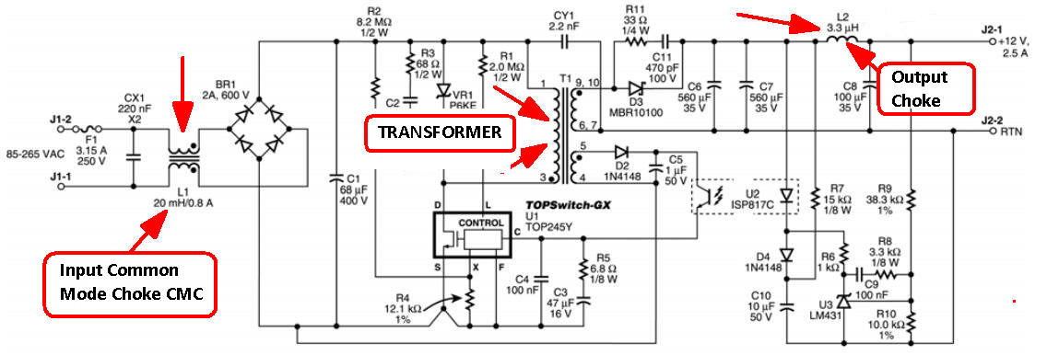
Transformer & Choke Service Premier Magnetics & Avnet-Abacus

Slide 4
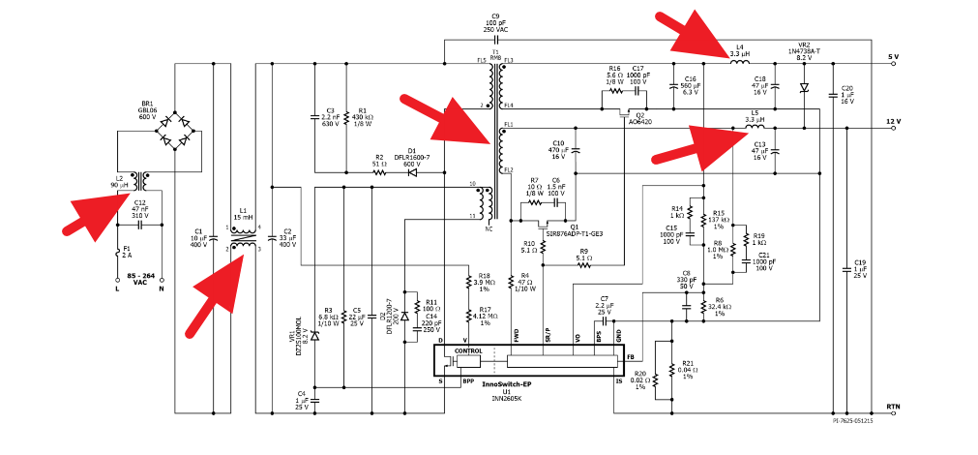
Transformer & Choke Service Premier Magnetics & Avnet-Abacus

Slide 5
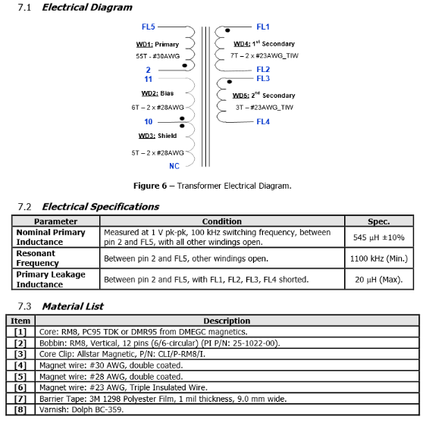
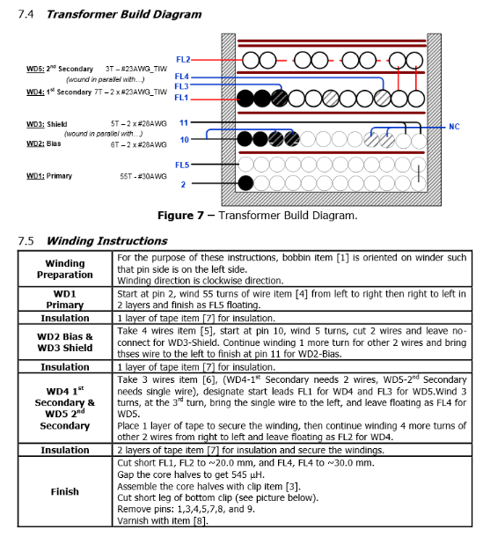
Transformer & Choke Service Premier Magnetics & Avnet-Abacus

Slide 6
Premier Magnetics & Avnet-Abacus
Premier Magnetics USA & China
Power, LAN, COM, Military Magnetics since 1991
Boeing-BE-Eaton-Emerson-Qualcomm-Siemens-TE-GE-Honeywell
Selected supplier for PI RDK’s
2-3 days for price and datasheet
6-10 days for FOC Samples for qualification
4-6 weeks for prototype’s made in USA
Bulk production from China
Very Competitive without compromise on Quality!

Slide 7
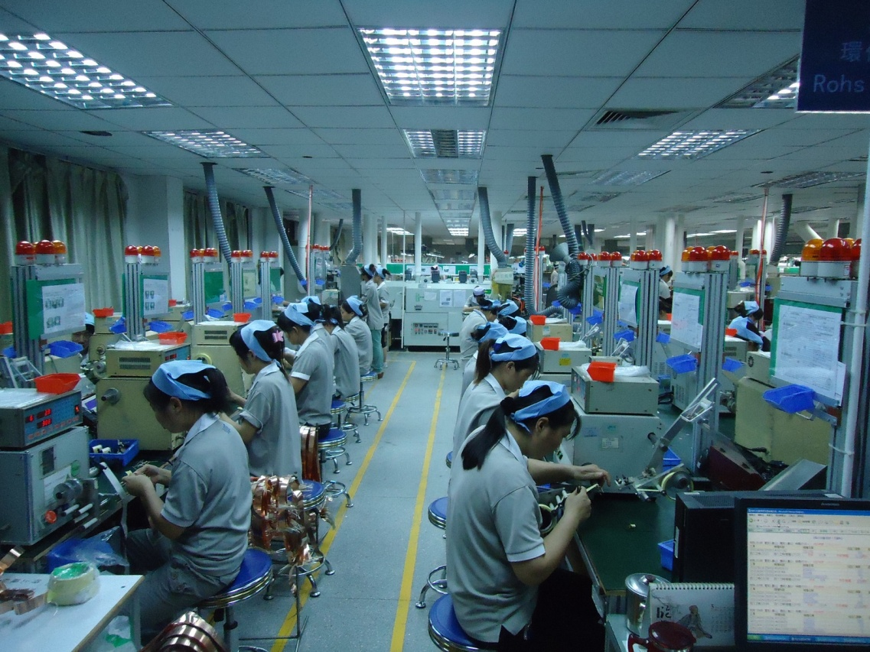
Transformer & Choke Service
offered from
Avnet Abacus
Thank You

